Slide 1

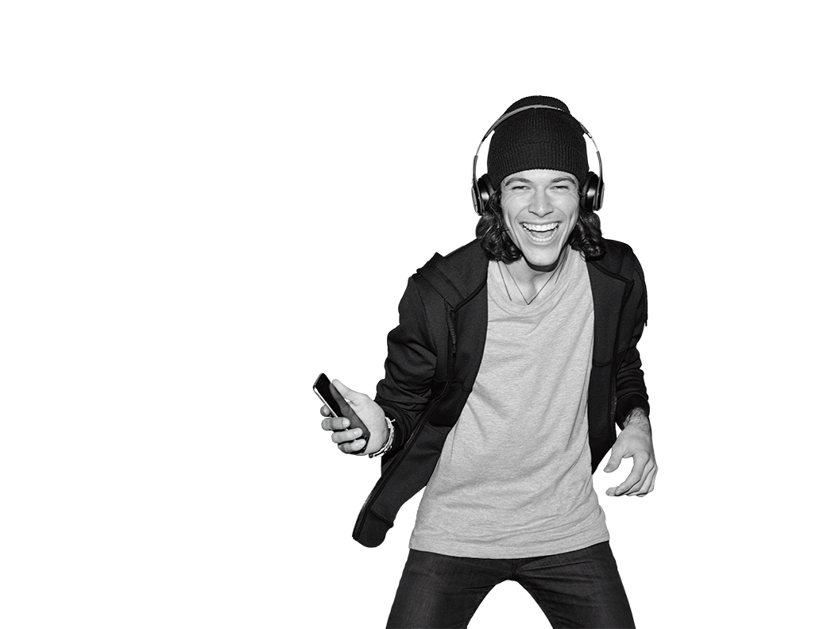


TR# 2017325

Slide 2
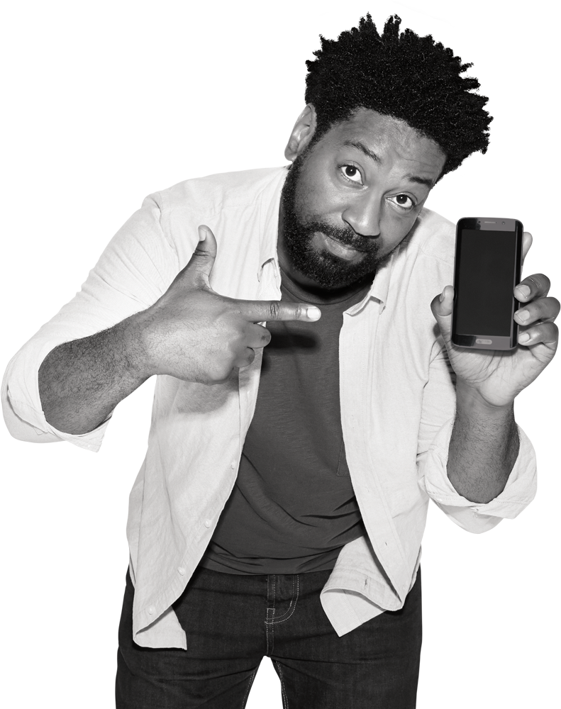

Rebellion
2 - Rebellion
T-Mobile confidential and proprietary information. Not for customer distribution.

Slide 3

INTRO
The Un-carrier Experience is a key differentiator.
We reinvented the customer interaction.
What about our systems?
Rebellion is the first huge step in making tools simple!
Unify the frontline, customer service, and the customer experience.
3 - Rebellion
T-Mobile confidential and proprietary information. Not for customer distribution.

Slide 4
INTRO
Rebellion in a nutshell!
It brings tons of benefits to the table.
It’s mobile, as in mobile first!
It’s a radical simplification of tools!
It’s empowering!
It benefits everyone!
4 - Rebellion
T-Mobile confidential and proprietary information. Not for customer distribution.

Slide 5
FAQ ACTIVITY
20 MIN
You have 10 minutes to complete the following with a 20 minute group debrief:
Access C2 & print or display the FAQ handout. DOC-439121
Search the FAQ document for the question and answer assigned.
Study the Q&A and be prepared to share the Q&A, with the class.
Bookmark the Rebellion Training FAQ’s C2 page on the computer or REMO. DOC-439121
5 - Rebellion
T-Mobile confidential and proprietary information. Not for customer distribution.

Slide 6
DO IT YOURSELF
1 HR 30 MINS
WALKME – REBELLION
Open the URL in Chrome.
https://retailtrainingprod.rebellion.t-mobile.com/
Log in with your NT Login.
Select Start in the pop up box.
Select the Training button in the lower right hand corner.
Under Getting Started, select Start.
Complete all six topics.
Getting Started
Launch the Welcome video
Close the video window.
Compete the Getting Started topic to be marked complete.
Account Refills
Account Maintenance
Activations
Devices
Resources
When reviewing the Resources topic, C2 documents are best accessed on the desktop.
6 - Rebellion
T-Mobile confidential and proprietary information. Not for customer distribution.

Slide 7
BRING IT TOGETHER
30 MIN
Be a Cosmic Hero Activity: You have 10 minutes to complete the following with a 5 minute group debrief:
Access C2 & print the Be a Cosmic Hero Activity handout. DOC-432261
Log into the Rebellion training environment using your NT login.
Lookup mobile number 554-879-5435.
Tap account Pia Patel, and tap Bypass.
Find features you can use to transform the transaction.
Explain how the feature benefits the customer experience and fits into our interaction model.
7 - Rebellion
T-Mobile confidential and proprietary information. Not for customer distribution.

Slide 8

The Download
Who would like to share what they found in the new system to Make it Personal?
How about Explore & Discover?
How about Problem Solved?
What about Guide the Purchase?
What about Stay Connected?
8 –Rebellion
T-Mobile confidential and proprietary information. Not for customer distribution.

Slide 9
BRING IT TOGETHER
15 MIN
What’s New Activity: You have 10 minutes to complete the following with a 5 minute group debrief:
Split the class into small groups of 3-4.
Access the Rebellion Training C2 page & print the Getting Underway - Fill in the Blank Activity handout. DOC-432261
Review the instructions.
Complete the activity.
9 - Rebellion
T-Mobile confidential and proprietary information. Not for customer distribution.

